Slide 1
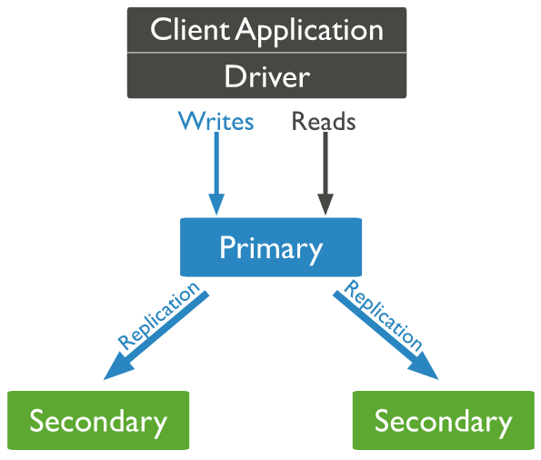

Replica Set Setup
Oplog

Slide 2
Replica Set Setup

